Slide 1

SCHOLARSHIP
INFORMATION
Dr. Martin LeBoldus Catholic High School

Slide 2
Scholarship Terms
Award - An award is given in recognition of outstanding achievement. Awards may be in the form of books, plaques, subscriptions or money. A monetary award is usually called a scholarship or bursary.
Bursary - A non-repayable grant of money. Bursaries are awarded primarily based on financial need, but academic achievement is also considered. Usually, the applicant must provide detailed documentation describing their financial situation when applying for a bursary.
Scholarship - A non-repayable sum of money awarded to a student to help finance further education. Most scholarships are based on merit in areas ranging from academic achievement to athletics. Usually, scholarships are not based on financial need.
Entrance Award/Scholarship - A scholarship or award given to a student entering his/her first year at a post-secondary institution. Also referred to as an Admission Award.
In-course Award/Continuing Scholarship - Awarded to students already enrolled in post-secondary studies, beyond the first year level. You will not be applying for these awards at this time.

Slide 3
TYPES OF SCHOLARSHIPS
Leadership
Community Involvement
Academic
Sports
Financial Need
Essay
Special Groups
8. Blended

Slide 4
How do I begin to get ready to apply for scholarships and bursaries?
Start by getting organized. Here is how……….

Slide 5
1. Compile an activity-based resume.
Use only the last 4 years
Include all contacts
Organize activities into activity areas:
Leadership
Volunteer
Community
Employment
Education/Courses
Goals/Future Plans
Accomplishments/Awards
Extra-curricular clubs/sports

Slide 6
2. Contact 2 references at least two weeks prior to the first scholarship deadline
Give them your resume
Give them the scholarship criteria
Ask them to save the letter

Slide 7
3. Begin the search
Parents and Grandparents: ask your employer, union, professional organization, service club, parish council, and community association
Students: ask your employer, survey the newspaper, search scholarship websites (including LeBoldus’) and Google.
Be prepared to write paragraphs, or essays.
Be prepared to be interviewed or make a presentation.

Slide 8
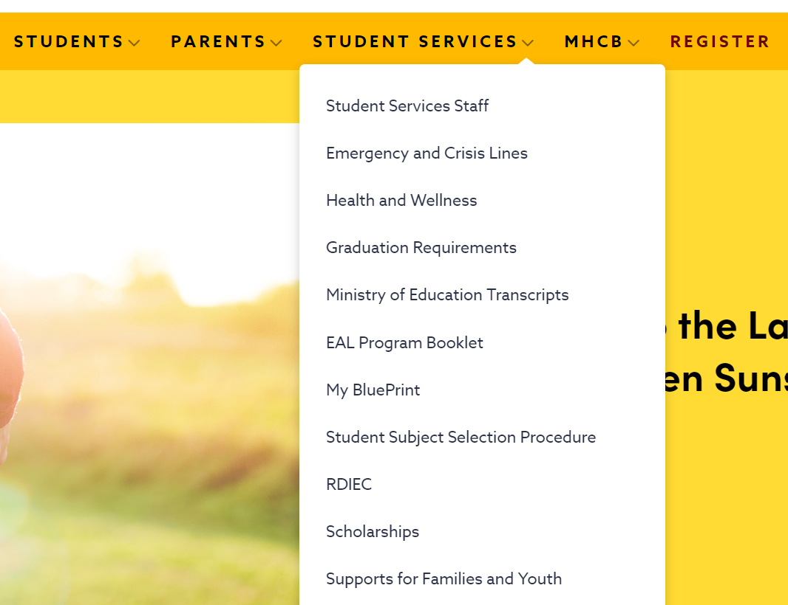

LeBoldus Student Services Tab contains Scholarship Information
It will be LIVE on Friday!

Slide 9

Automatic Entrance Awards:
University of Regina
90-92.99% - $1000
93-94.99% - $1500
95+ - $3000

Slide 10
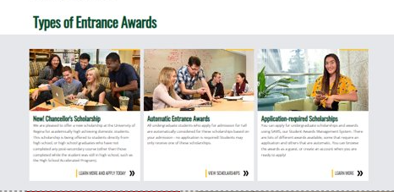
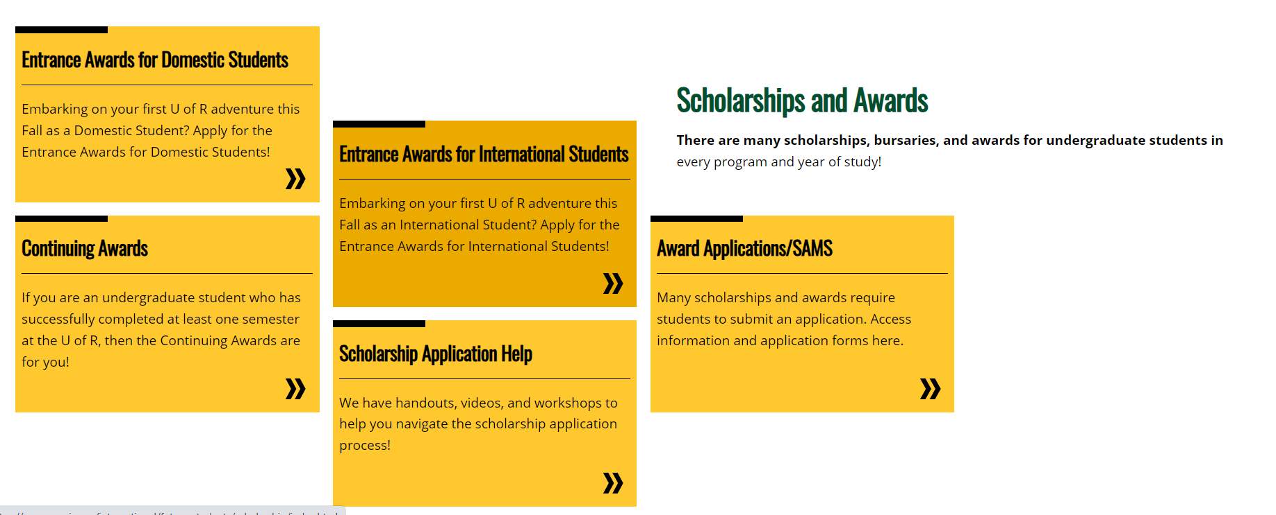
Scholarship Workshops
Feb 13 – in person
Feb 21 – Zoom
Feb 29 – in person
Mar 7 – Zoom
Michael Paul from the UofR will also come to LeBoldus and host a scholarship session

Slide 11
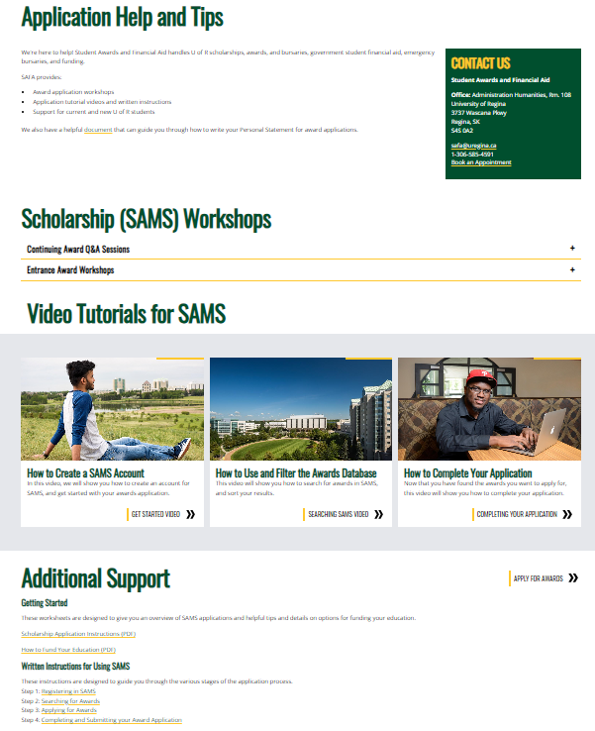

Slide 12

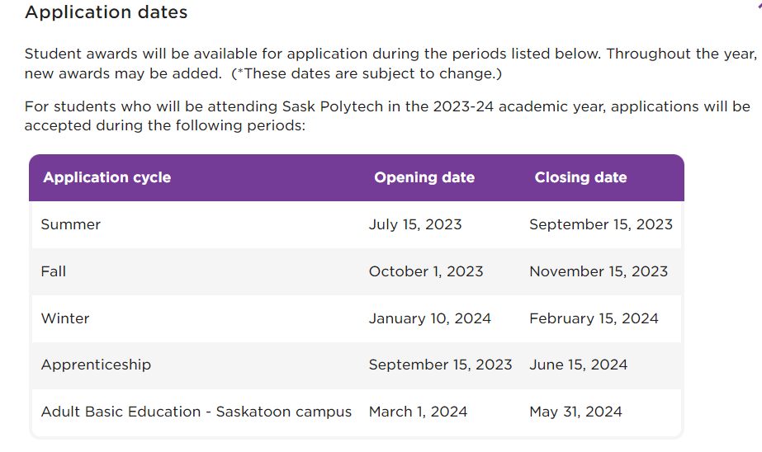

Slide 13

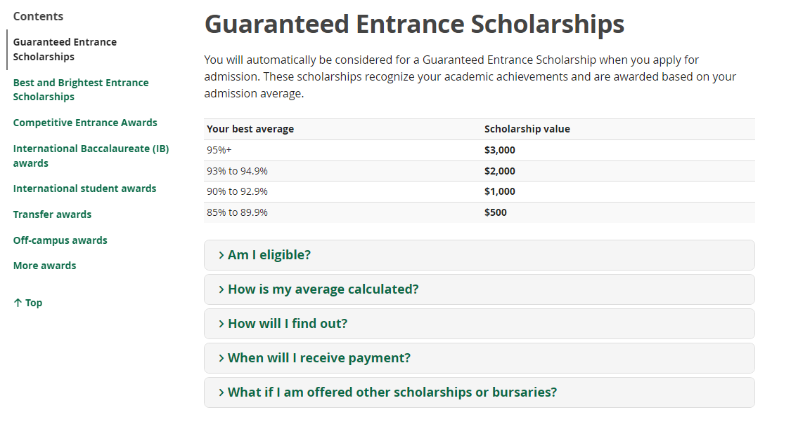
Virtual Scholarship Sessions - Nov. 16 & 23

Slide 14

www.scholarshipscanada.com

Slide 15
Be organized!
Keep a file of scholarship information including:
- copies of completed applications
- reference letters
- e-files of written work
Be neat!
Your completed application reflects your skills and abilities.
Read and follow directions !
Beat deadlines by at least 3 days !

Slide 16
Thank you.
Have a Great Day!
Good Luck with your Search!!

