Slide 1
SCHOLARSHIP INFORMATION
October 20 , 2021
Dr. Martin LeBoldus Catholic
High School

Slide 2


SCHOLARSHIPS, AWARDS AND BURSARIES
Show
me the money…

Slide 3
Scholarship Terms
Award - An award is given in recognition of outstanding achievement. Awards may be in the form of books, plaques, subscriptions or money. A monetary award is usually called a scholarship or bursary. Bursary - A non-repayable grant of money. Bursaries are awarded primarily based on financial need, but academic achievement is also considered. Usually, the applicant must provide detailed documentation describing their financial situation when applying for a bursary.
Scholarship - A non-repayable sum of money awarded to a student to help finance further education. Most scholarships are based on merit in areas ranging from academic achievement to athletics. Usually, scholarships are not based on financial need.
Entrance Award/Scholarship - A scholarship or award given to a student entering his/her first year at a post-secondary institution. Also referred to as an Admission Award.
In-course Award/Continuing Scholarship - Awarded to students already enrolled in post-secondary studies, beyond the first year level. You will not be applying for these awards at this time.

Slide 4
TYPES OF SCHOLARSHIPS
Leadership
Community Involvement
Academic
Sports
Financial Need
Essay
Special Groups
8. Blended

Slide 5
How do I begin to get ready to apply for scholarships and bursaries?
Start by getting organized. Here is how……….

Slide 6
1. Compile an activity-based resume.
Use only the last 4 years
Include all contacts
Organize activities into activity areas:
Leadership
Volunteer
Community
Employment
Education/Courses
Goals/Future Plans
Accomplishments/Awards
Extra-curricular clubs/sports

Slide 7
2. Contact 2 references at least two weeks prior to the first scholarship deadline
Give them your resume
Give them the scholarship criteria
Ask them to save the letter

Slide 8
3. Begin the search
Parents and Grandparents: ask your employer, union, professional organization, service club, parish council, and community association
Students: ask your employer, survey the newspaper, search scholarship websites (including LeBoldus’) and Google.
Be prepared to write paragraphs, or essays.
Be prepared to be interviewed or make a presentation.

Slide 9


Slide 10
Automatic Entrance Awards:
University of Regina
90-92.99% - $1000
93-94.99% - $1500
95+ - $3000

Slide 11
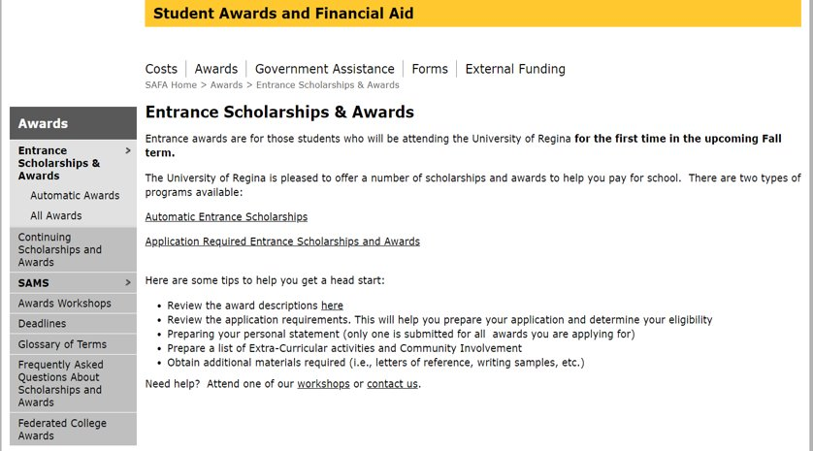
www.uregina.ca/awards

Slide 12
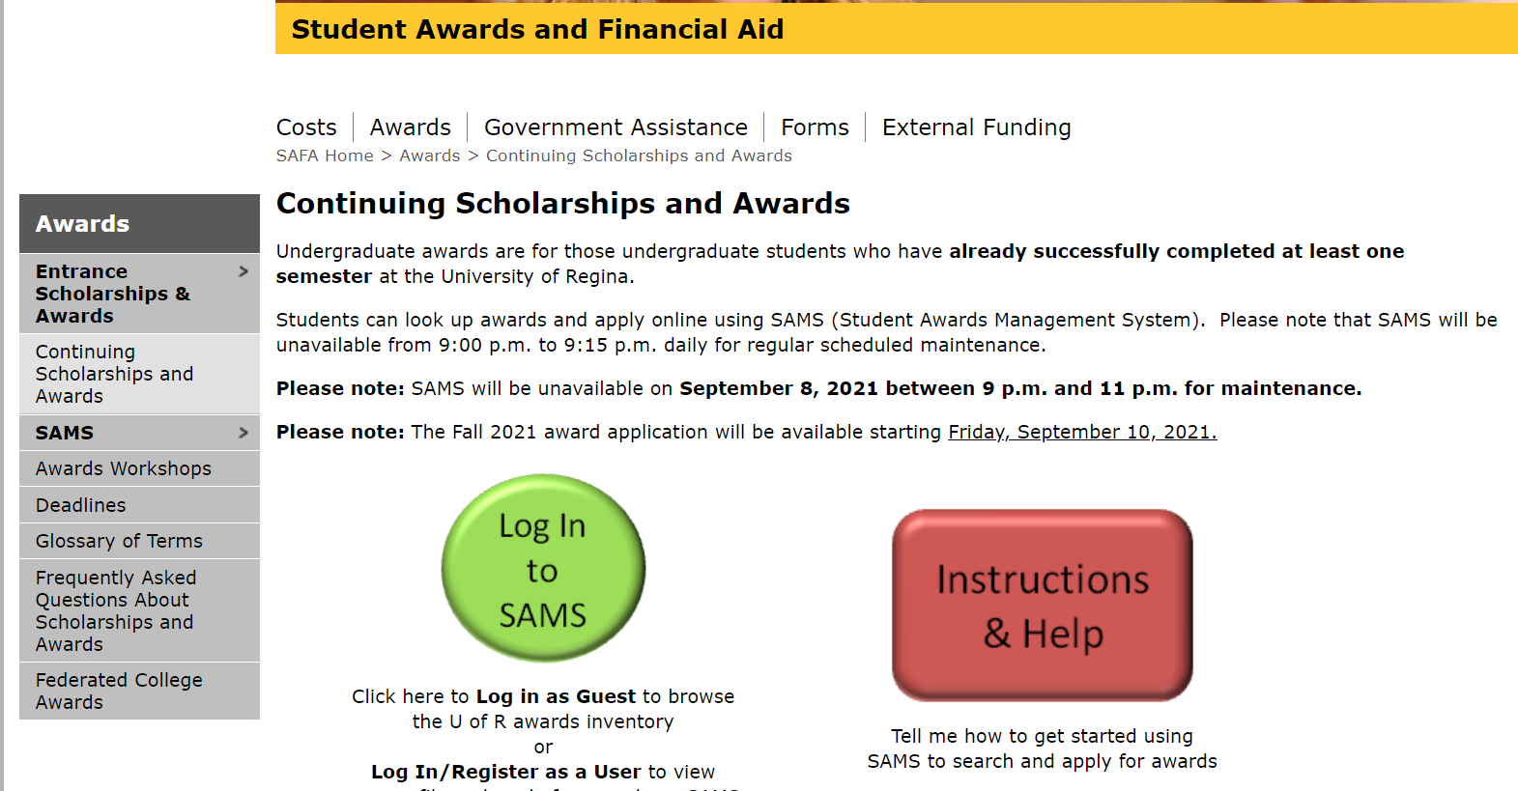

Slide 13


Slide 14
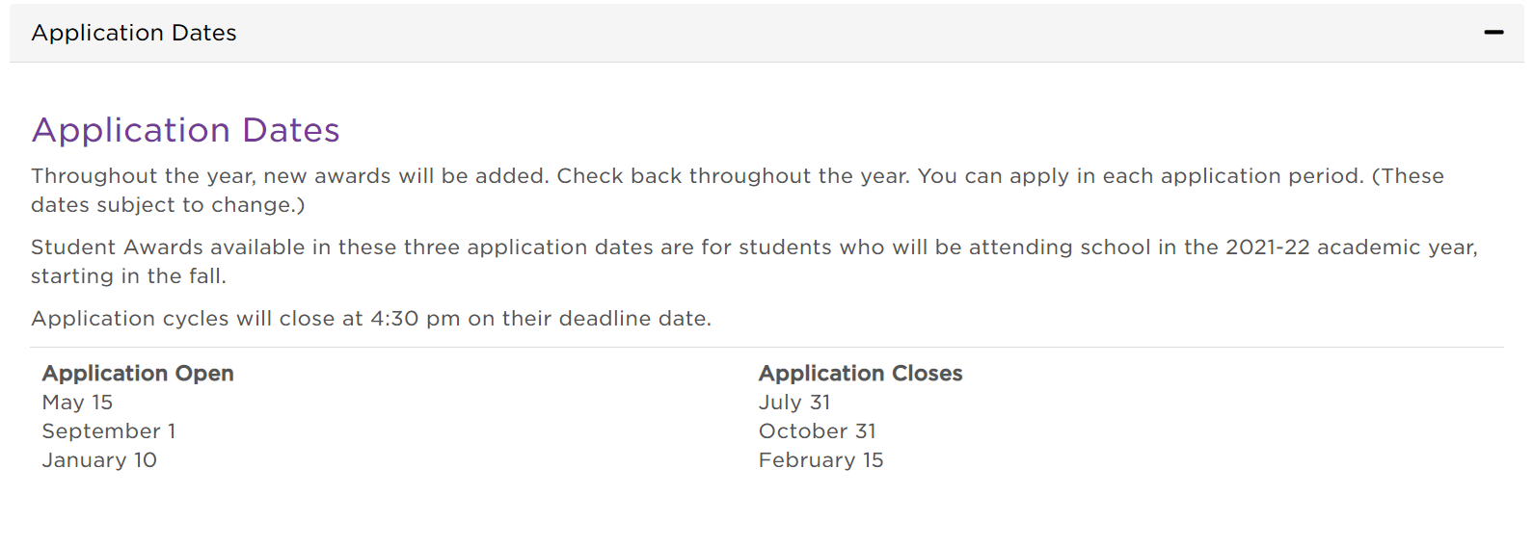

Slide 15


Slide 16
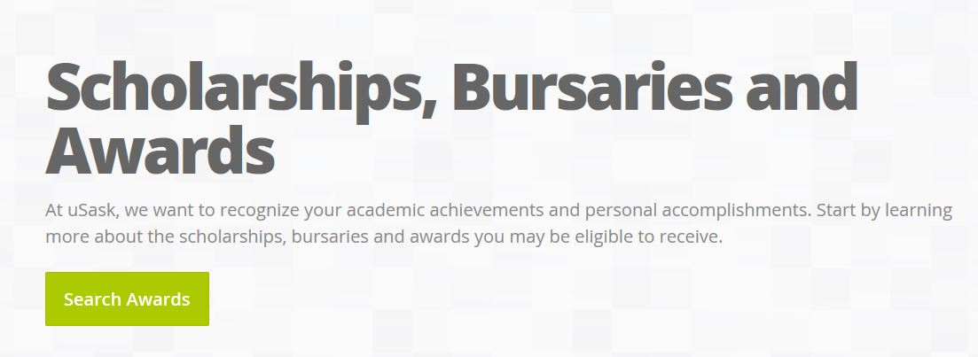
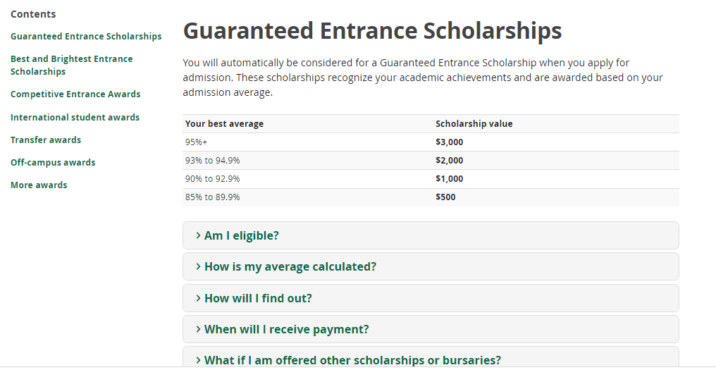

Slide 17

www.scholarshipscanada.com

Slide 18
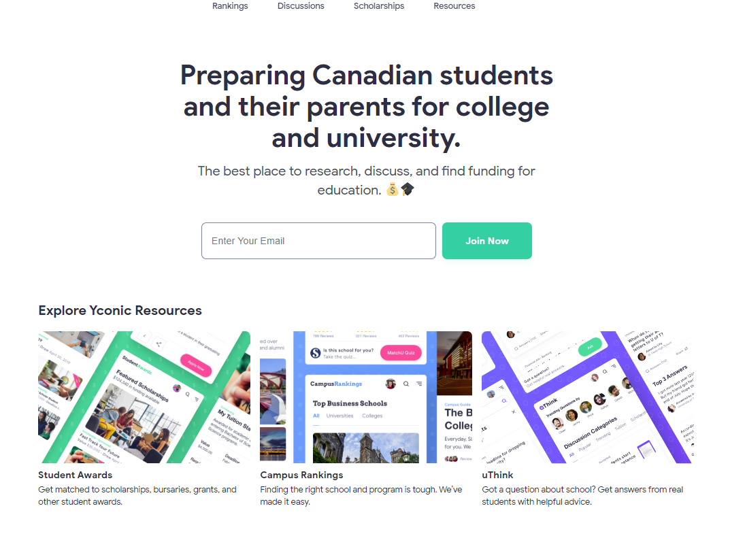
https://www.yconic.com/

Slide 19
Other websites for searching for scholarships include:
www.schoolfinder.com
www.rcsd.ca/leboldus
www.canlearn.ca
Student Loan websites:
Saskatchewan student-loans
Canada Student Loans

Slide 20
Be organized! Keep a file of scholarship information including: - copies of completed applications - reference letters - e-files of written work
Be neat! Your completed application reflects your skills and abilities.
Read and follow directions !
Beat deadlines by at least 3 days !

Slide 21
Thank you. Have a Great Day! Good Luck with your Search!!

